Slide 1
PRESENTATION ON SHAFT SINKING TECNOLOGY

Slide 2


Slide 3
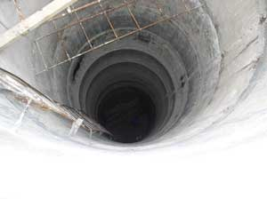
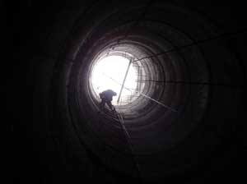
SHAFT SINKING TECHNOLOGY

Slide 4
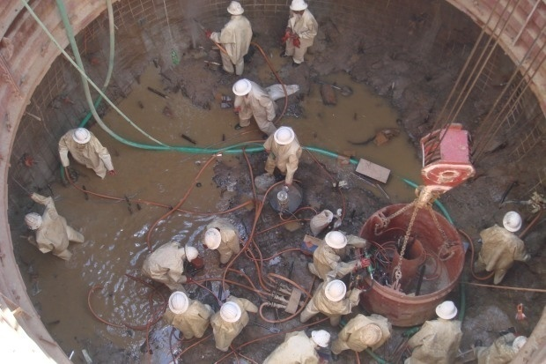

Slide 5
OPENING OF A COAL SEAM
Establish access to a coal seam and develop it for its exploitation.
It can be O/C or U/G.
For u/g opening can be by Shafts or Inclines or adits depending on geology and topography of the mine area.
A combination of shaft and drift is practiced normally.

Slide 6
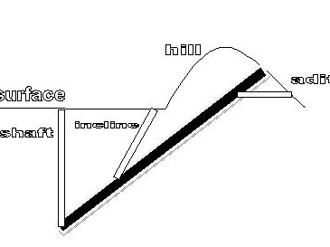

Slide 7
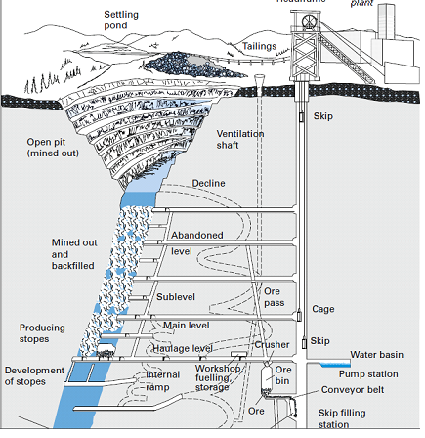

Slide 8
COMPARISON BETWEEN SHAFT AND DRIFT
Time required to reach full production is much less if the mine is opened by drifts (50 % roughly)
Capital cost of driving and equipping a drift is 50% less than sinking and equipping a shaft
Continuous conveying is possible with drifts.
Power costs are low in drift transport(30%).
Conveying capacity of drift is much large up to 12 MT against 4 MT in case of vertical shafts.
Transporting time is higher in case of drifts.

Slide 9
Operational costs of drifts are low.
Larger equipment can be handled in shafts. Material transport is slow in drifts.
Resistance offered to ventilation is less in shafts apart from better locating case for electric cables, water and compressed air pipes.
Greater probability of drift passing through geologically disturbed areas.
Loss of coal in protective pillars is much more in case of shaft.
Less environmental problem than shafts because of their lower profile on the surface.

Slide 10
FACTORS DETERMINING THE LOCATION OF A SHAFT ARE:
TECHNICAL
ECONOMICAL
HYDROLOGICAL
OTHER FACTORS

Slide 11
TECHNICAL
1 . Geological, hydrological and graphical
consideration. 2 . Level ground 3 . Free from faults, folds, dykes, washouts etc. 4 . Rock should be competent. 5 . Make of water should be minimum.
6 . Bearing strength of ground: adequate to bear
the structure of head gear and buildings.
7 . Loss of coal in shaft pillar should be minimum.
8 . Land slide in hilly terrain should be considered.

Slide 12
HYDROLOGICAL
Shaft height should be above last 100 years highest flood level (HFL).

Slide 13
ECONOMICAL
1. T-km Transport Effort is minimum.
2. Main and Auxiliary ventilating fans work to their optimum capacity and efficiency.

Slide 14
DIFFERENT LAYOUTS OF LOCATING A SHAFT

Slide 15
DOWN CASTE
3rd most shaft i.e. service shaft on the rise most boundary can be used for transporting the slurry down the mine.
It can also be used for ventilation.
But sinking additional shaft could be quite costly.
(A)

Slide 16
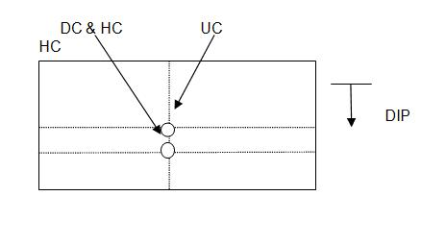
After sinking it is easy to connect the two shaft with a short connection to provide Normal ventilation to the face.
It is possible to make surface layout more compact and also to reduce the total no. of pit Bottom excavation.
B
(B)
In an emergency main winding shaft can be used after coal winding and also when the Main shaft is stopped for repairs.
Total area of shaft pillar left is comparatively less.

Slide 17
DOWN CASTE
Ventilation shaft is shallower.
Accessional ventilation is possible during the whole life of the pit.
But establishment of connection between the shaft is delayed
( C )

Slide 18
DOWN CASTE
There are equal length of ventilation circuits along the levels and the water gauge is Equal.
While working in the dip, there may be difficulty in ventilation.
Surface arrangement are spread over long distance.
(D)

Slide 19
HOWEVER ‘MODEL (A)’ IS MOST FAVORABLE UNTIL A VERY HARD STRATA IS FOUND AROUND COAL.
IN THAT CASE THEN ‘MODEL (C)’ WILL BE PREFERRED.

Slide 20
SHAPE OF THE SHAFT OPENING CAN BE :-
1. Circular
2. Elliptical
3. Square
4. Rectangular

Slide 21
SHAPE OF THE SHAFT DEPENDS ON
Stability (Stress direction/distribution).
Cost of construction(Excavation, Supporting etc.)
Maintenance(life time).
Operational cost.
Positioning convenience.
Space utilization ( for pipe lines, electric cables and cages etc.)

Slide 22
SIZE OF THE SHAFT IS DETERMINED BY
1. Thickness of lining required considering the type of strata, load, FOS etc.
2. Production/day - Size of the tub, capacity, clearances skip.
3. Maximum persons employed in a single largest shift(ventilation)

Slide 23
METHODS OF SHAFT SINKING THROUGH WATER BEARING STRATA
 | METHOD | ROCK MASS | THICKNESS OF WB STRATE | WATER INFLOW | DEPTH RANGES | REMARKS
1 | Pile wall Wooden Sheet pile wall | Quick sands(soils saturated with water and having no stones) | 2-6m | Limited | 6-15m Adv 2.5m/month | Limitation: Required presence of impervious strata of clay into which the piles can be driven to lock water in.
2. | Concrete Pile wall drilled or driven piles | Quick sands soils, loose rocks clays saturated with water(with stone) | 6-10m | --- | 25-30 Adv 6-10 | Concrete pile wall can be used as a foundation for a shaft head gear

Slide 24
3. | Caisson method without pumping in flow rocks with steady pumping in weak and loose water bearing rocks | Uniform flow rocks or loose rocks | 10-15 | Not limited | 30 or more with special vibrators Adv/month 10-20 | Little dip, preferably flat, presence of clay strata of 2-3m thickness below the water bearing zone.
4. | Caisson with compressed Air | Loose, non coherent water bearing strata | 8-30 | Moderate | Up to 40 Adv 20-30m | Maximum pressure in air chamber is 3 to 3.5 atmosphere
5. | Depression of ground water level | Mid and coarse solids and gravels with coefficient Of filtration 10-100m/day fractured competent rock | 20-30 | great | around 100-150m Adv 15-20 | Not applied in clay rocks, quick sands and alternate patches of permeable and non permeable rocks.

Slide 25
6. | Grouting (Cement) | Competent rocks with tissues and cracks filled with water (SST, Sh, MST, LST) coarse sands and gravel | Not Limited | 10m³/hour | Any adv. condition 10-15 - bad 20-30 - good | Not recommended in flow rocks or quick sands with water flow vel. > 0.80m/day/Large voids.
7. | Chemical grouting | Sands with clay not more than 10-15% C.F=2-80m/day Competent rocks with small tissue | a few | Moderate | Unlimited | used an additional interventional method

Slide 26
8. | Grouting(with clay) | water bearing rocks with large cracks and voids | not limited | not limited | not limited Adv 10-15 | can be used in presence of aggressive waters usually applied in conjunction with cement grouting
9. | Bitumination | Competent rocks with large cracks voids also gravels | 20-30 | Mid and large | Up to 40m | Used as a local sealing method against aggressive waters

Slide 27
10 | Freezing of the rock mass | All types of water bearing rocks | 10 to 1000 | Not limited | depending on depth up to 50 | reliable but costly and time consuming(drilling holes and freezing them)
11 | Shaft drilling | Weak, water bearing strata | Several hundred | Not limited | Up to 600 | Thickness of competent hard rocks not supposed to exceed 10% of over all thickness of WBS

Slide 28
SHAFT SINKING THROUGH WATER BEARING STRATA
1. Wooden piling
2. Caisson method (brick/steel)
3. Cementation
4. freezing

Slide 29
WOODEN PILING METHOD
The initial diameter of the shaft collar
Dg should be established according
to the following:
D_{g}= d+2(d+2b+c+f) Where d=permanent lining b=width of guide rings c=thickness of driven piles f= thickness of guide beams
Generally this method is used for shallow depth and for small thickness of water bearing strata , normally 2-6 meters.

Slide 30
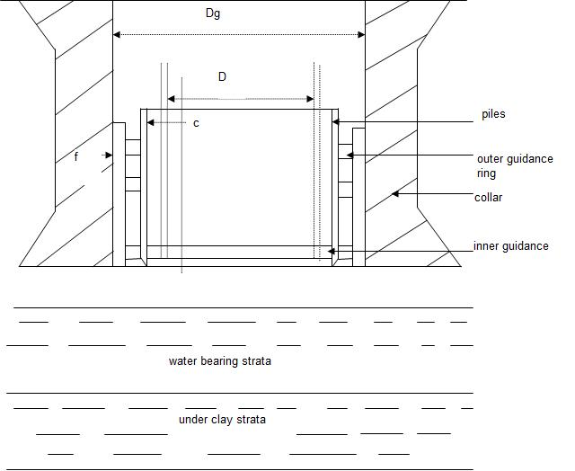
WOODEN PILING METHOD

Slide 31
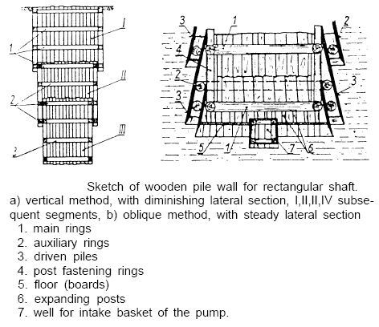
WOODEN PILING METHOD

Slide 32
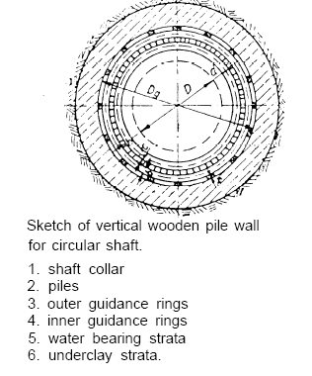
Notes:
Wooden pile

Slide 33
CAISSON METHOD
Weight of the caisson : Q
Resistance of water bearing strata: F
Buoyant force of water : G
Outer dia. :D2
Inner dia. :D1
Specific gravity of lining material : r
Height of caisson : H
Weight of cutting toe : B
with water being pumped out : Q > F
without pumping water : Q > F + G
Q = π (D₂² - D₁²) r H + B
4
Q’=Q-G (weight of caisson partly submerged to depth H)
Where G= π (D₂² - D₁²) Hw. σw + VB. σw
4

Slide 34
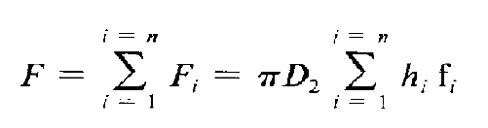
Hw is height of submerged part of caisson in meter.
V is volume of cutting toe in m3.
δw is specific gravity of water in t/m3.
For shallow caissons, the recommended value of friction force per unit area is in the range of 2.25 to 2.5 t/m2 (when the depth of caisson does not exceed 75 ft or 25 m)
where fi is friction force per unit in a particular strata in t/m2, and hi is thickness of particular strata in meter.

Slide 35
If either condition, Q > F or Q > F + G, is not fulfilled,
then the caisson will not sink and special methods are required,
such as
(1) some means to diminish friction between the
lining and ground, or
(2) additional load Q provided by ballast or
jacking.
It is possible to diminish the friction by injecting water at 30 to 45 psi (210 to 320 k Pa), or more than hydrostatic pressure, through the holes in the cutting toe.

Slide 36
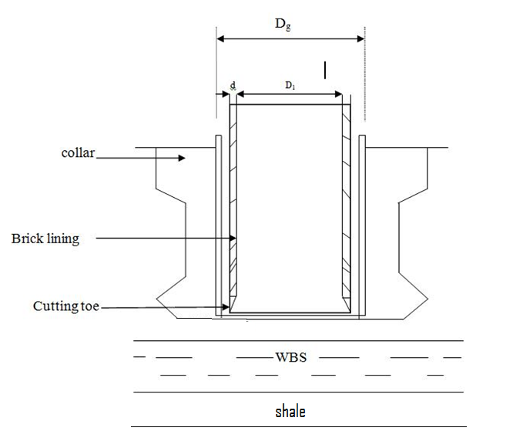

Slide 37
SINKING METHOD WITH THE DEPRESSION OF WATER TABLE
Design consideration for application of this method must
be preceded by:
1. Choice of the most suitable way for depression of the
water table in given conditions.
2. Determination of the number, spacing, diameter, and
depth of the wells.
3. Calculation of the radius of the depression cone,
amount of water to be pumped out, and the height of
the remaining wet portion of the water-bearing strata.
4. Equipment, hardware, and pumping facilities.
5. Choice of the auxiliary method to go through the wet
remainder of the water-bearing strata.

Slide 38
SINKING WITH DEPRESSION OF WATER TABLE
To lower the water table in the area of shaft sinking, the
following system can be applied:
1. Pumping water from three to six depression wells drilled
around the planned shaft perimeter, placed on a circle
about 12 ft (4 m) larger than the diameter of the shaft
excavation.
2. Draining water through drill holes to existing openings in
the mine below.
3. Draining water through drill holes to water-absorptive
strata (e.g., dry sands under water-bearing strata).
The first of these systems is the one, most often used.

Slide 39
WELLS. Wells are drilled with 14 to 20 in. (300 to 500 mm) diameters, without drilling mud. They are spaced uniformly around the future excavation. Within the range of the water bearing strata, they are equipped with filters perforated by round or elongated holes 0.2 to 0.35 inch(5 to 10 mm) in diameter , spaced in a checker design, with an outside screen having eyes 0.015 to 0.035 in. (0.4 to 0.9 mm) in diameter, sized against entry of sand particles. Generally, the construction of the filter must be suitable for the character of strata to be drained. Submersible drainage pumps have a wide capacity range,
varying up to 92,500 gal/hr (350 m3/h).

Slide 40
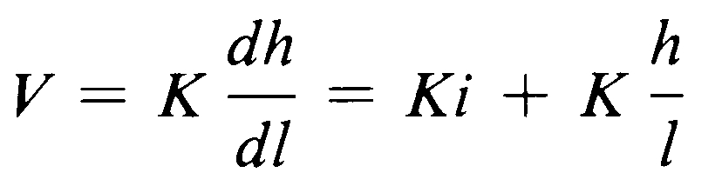
The movement of water through a porous media is
given by the Darcy formula
Where:
V = mean velocity of flow per unit time through a unit area
or mean filtration velocity in m/s;
h = (h2 – h1), or the difference of water levels in the ground
(depression) created by pumping water or head loss
during flow;
l = distance in which head loss appears in m,
K = coefficient of filtration (permeability factor) in m/s
i = (h2-h1)/l ,or head loss over a unit distance (hydraulic
gradient), which is a dimensionless quantity.

Slide 41
Elements of shaft Excavation Design
(A)
Description Of Geological Column, Rock Strata, Geotechnical Parameters And Ground Water Flow
Determination of Shaft dia.
Choice of Shaft Sinking Technology
Shaft lining Design
Shaft Foundation, Their Locations And Dimensions

Slide 42
7. Shaft Collar, Its Depth, Foundation, Thickness,
construction Material.
8. Shaft Sump, Its Depth, Pumping And Cleaning
arrangement
Surveying Data for Particular Shaft Elements
Ground And Water Pressure on Lining, Shaft Insets,
Dimensions, Air Flow Capacity
Schedule Of Construction(Preparatory Work, Sinking,
Lining, Equipment Erection And Liquidation)
12. Cost specs
13. Shaft Design Drawings

Slide 43
(B)
(i) Drilling and Blasting - Basis of special charge assumption
pattern , powder Factor , delays
explosive details
(ii) Temporary and permanent support:
Temporary:
Roof bolt - (2.4m long, 22mm dia. with bearing plate)
Shotcrete - (sealing shotcrete 1” and final layer of 1)
Wire mesh - (embedded in between these layers )
Permanent: Monolithic concrete of calculated thickness of
lining , bitumen layer in between to adjust for
any lateral movement without damaging
lining.
NOTE: The time lag between temporary support and permanent lining is dictated by the competence of ground which can be estimated by collecting in formation regarding ɸ , h , ɸ_{c}

Slide 44
(C) Equipment deployed
Jack hammer - 3 numbers (for 38 mm dia. holes)
Compressor - for operating jack hammers
winches - for hoisting(initially)
Head gear
Winding system - Designed considering the final hoisting
capacity
Mucking Grabs and buckets
Scaffolding -for operating staff of roof bolting
Shotcreting equipment
Concrete mixer and steel liners(movable, flexible)
Fan (auxiliary exhaust type) with dust traps
Exploder
Pump

Slide 45
(D) Time cycle for sinking
Drilling and blasting - 5 hr (Since 3 setups are available)
De-fuming - 15 min
Dressing - 30 min
Mucking - 5 hrs
Supporting - 1 hr
Surveying and pattern firing - 30 min
Travelling(up and down) - 45 min
-----------------------
13 hrs/ cycle
---------------------
Progress - 2m/blast or cycle
Monthly progress = 26 x 24/13 x2 = 96m
Assuming 80% efficiency of operations = 96 x 0.8 = 76.8m
Hence the monthly progress is 75m/month .

Slide 46
(E). Man Power
Drillers face supports - 10
Charging gang/carrying gang
(Some Of The Drillers Can Be Used For This) - 3
Shot firer - 1
Mucking Attendant - 2
Winch Operator - 1
Supervisor - 1
Electrical Fitter - 1
Mechanical Fitter - 1
Pump Operator &Attendant - 2
Duct Extension Attendant - 2
Compressor operator - 1
----------------
25/cycle
-----------------

Slide 47
(F) Cost of sinking
approximately Rs. 2 to 3 lakhs/m of progress.
Main components that costs are mucking , lining , ventilation , pumping etc.

Slide 48
THANK YOU

